Slide 1

SKINCARE PRODUCT MANAGEMENT SYSTEM
Group Members :
1. Anusha Gondhalekar 20104127
2.Sakshi Balekar 20104103
3.Maaz Mirza 20104124
4.Hamza Ansari 20104058
Project guide
Prof. Vidya Shet

Slide 2
CONTENTS
1. Introduction
2. Objectives
3. Scope
4. Features
5. Outcome of the project
6. Technology Stack

Slide 3
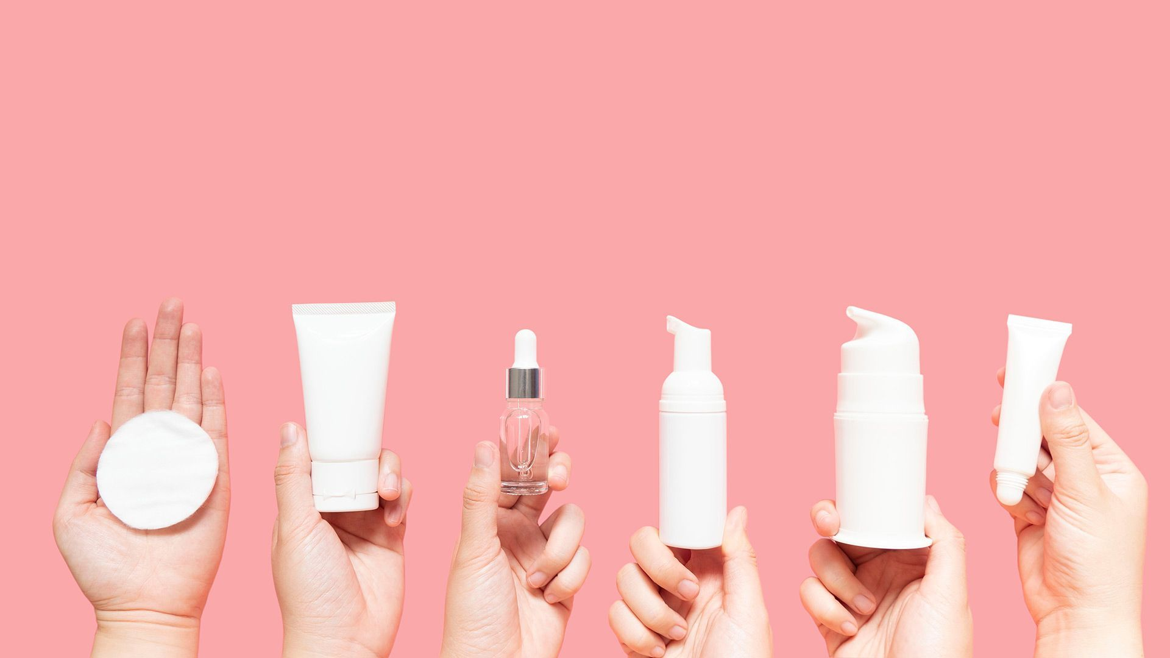
1. INTRODUCTION
Problem Identified :
People are unaware about their skin type.
They keep experimenting on their skin by blindly opting various products in the market.
Waste their time and money in searching for a proper skincare.
Rely on their friends advice or vague blogger reviews.
All these reasons can cause serious skin conditions or can severely damage their current skin.

Slide 4
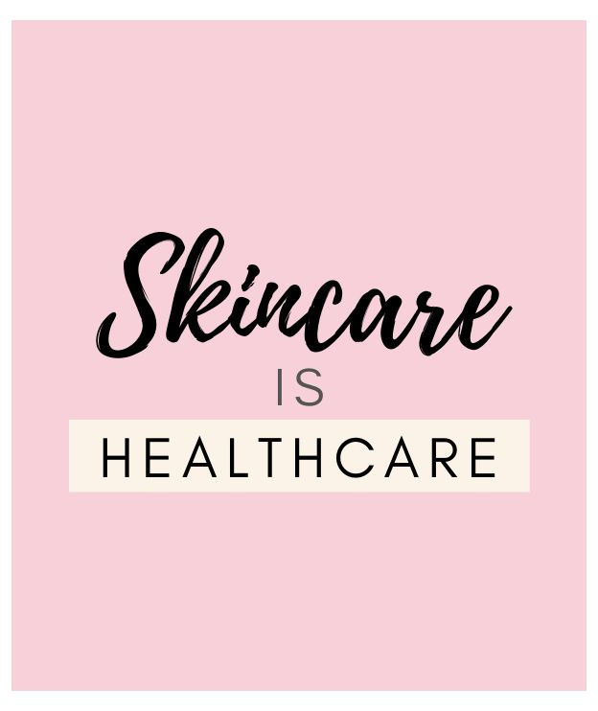
Solution Proposed:
Here we have come up with a revolutionary approach to skincare by customizing skincare products based on your skin type and issue.
The main purpose of this study is to develop an web-based application that can judge the skin characteristics of users, and let the users find suitable skin care products for their own use.

Slide 5
2. OBJECTIVES
To help consumers address their skin concerns and help them explore more about their skin.
To enable consumers to give out a well-researched simplified, fact-based quiz.
To suggest a dermatologically approved skincare routine based on the skin quiz.
To choose a wise pricing plan and accordingly place your order.

Slide 6
3. SCOPE
Can be applied in cosmetic sector where consumers are moving towards integration of health and wellness.
Can offer great deal in Beauty and Personal care market as per consumers demand of enhancing their natural skin.
Can be useful to all age groups and is not restricted to any gender.

Slide 7
4. FEATURES
The key feature of our app is the skin analysis and knowledge provided about the ingredients used for a particular skin-type.
It is not necessary for all the consumers to subscribe to a plan.
The skin quiz is well researched and designed in such a way that will help our consumers to know their skin so that we can formulate customized skincare routine.
We have planned a perfect subscription plan which consists of four products with decent pricing for best results.

Slide 8
5. OUTCOME OF PROJECT
Consumer can give out skin analysis test.
Consumer can know more about their skin based on their skin analysis and then will be provided with a proper skincare routine.
Consumer can opt for a suitable pricing plan and accordingly place their order.
Consumers can just give out the skin test to know about their skin type and condition and get acknowledged with the key ingredients to be used in any other brands products.

Slide 9
6. TECHNOLOGY STACK
Programming language : Java
Operating system : Windows 10
Development environment : Apache NetBeans
Database : PostgreSQL
Framework: Java Swing

Slide 10
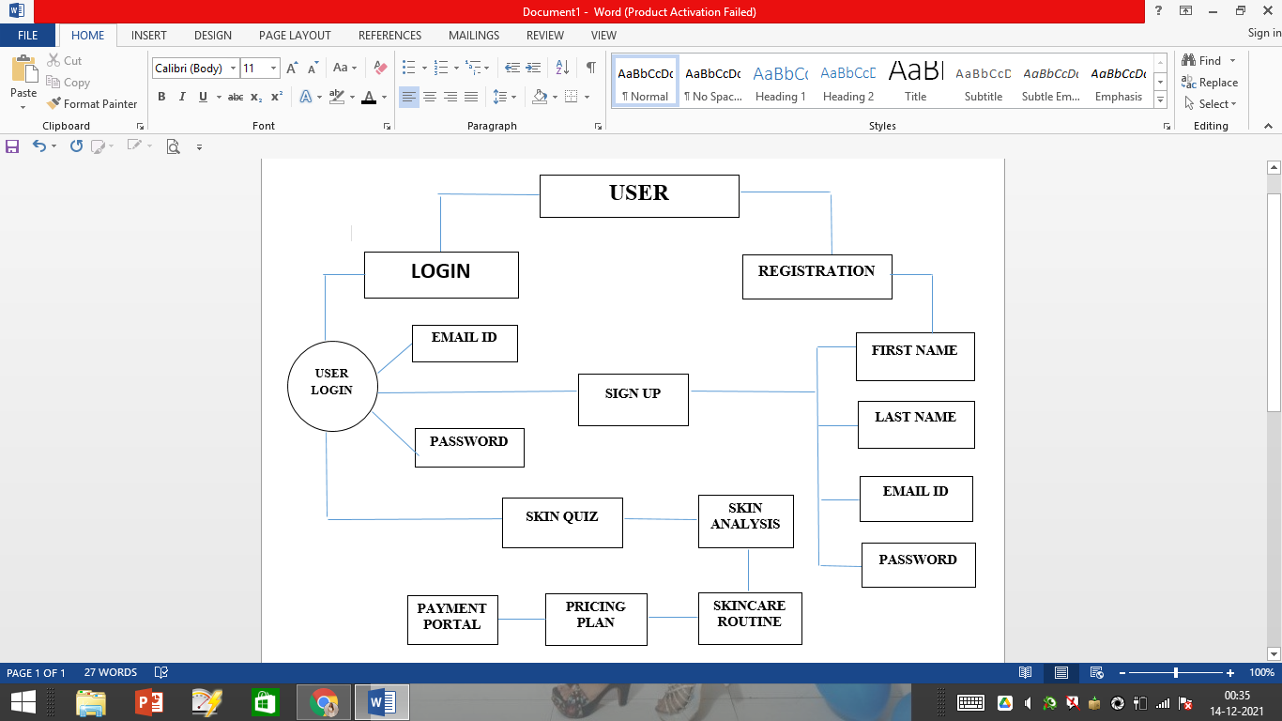
Block Diagram

Slide 11
THANK YOU!

